Slide 1
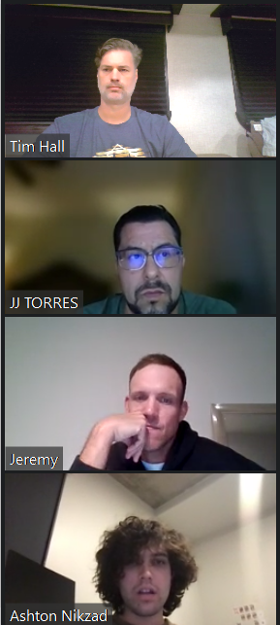
Arizona Residential Real Estate Analysis
Team 2 Presentation

Slide 2
Team Members & Duties
Ashton Nikzad
Jeremy Brown
JJ Torres
Tim Hall
Data importing, cleaning, and analysis:
Jeremy and Ashton
Plots
JJ
Presentation
Tim

Slide 3
Solving for these questions:
Question 1:
If you were to invest today, which zip codes have the lowest cost investment per square ft. = (Best Investment)?
Question 2:
Identification of Low Risk, High Yield (Best Investment) Property categorized by Property Type, Bedroom size, community amenities?
Question 3: Is the housing market in Arizona healthy and sustainable.

Slide 4
Our Audience:
Small, or Individual, Residential Real Estate Investor(s)
Single Family Buyers
Local Real Estate Agents

Slide 5

Input Data Sources
Rapid API: https://us-real-estate.p.rapidapi.com/v2/for-sale
From Datausa.io
proptaxes.csv
propvalue.csv
rentvsown.csv
state_market_tracker.tsv000
Redfin Real Estate News: https://www.redfin.com/news/data-center/
Median Household Income.csv
Median_sale_price.csv
Property Values.csv
Property Taxes.csv
https://raw.githubusercontent.com/plotly/datasets/master/
us-cities-top-1k-multi-year.csv

Slide 6
Imports
import pandas as pd
import json
import requests
import plotly.express as px
import hvplot.pandas
import geopandas
from urllib.request import urlopen
import numpy as np
import seaborn as sns
import plotly.figure_factory as ff
%matplotlib inline

Slide 7
If you were to invest today, which zip codes have the lowest cost investment per square ft. = (Best Investment) ?
Question 1

Slide 8
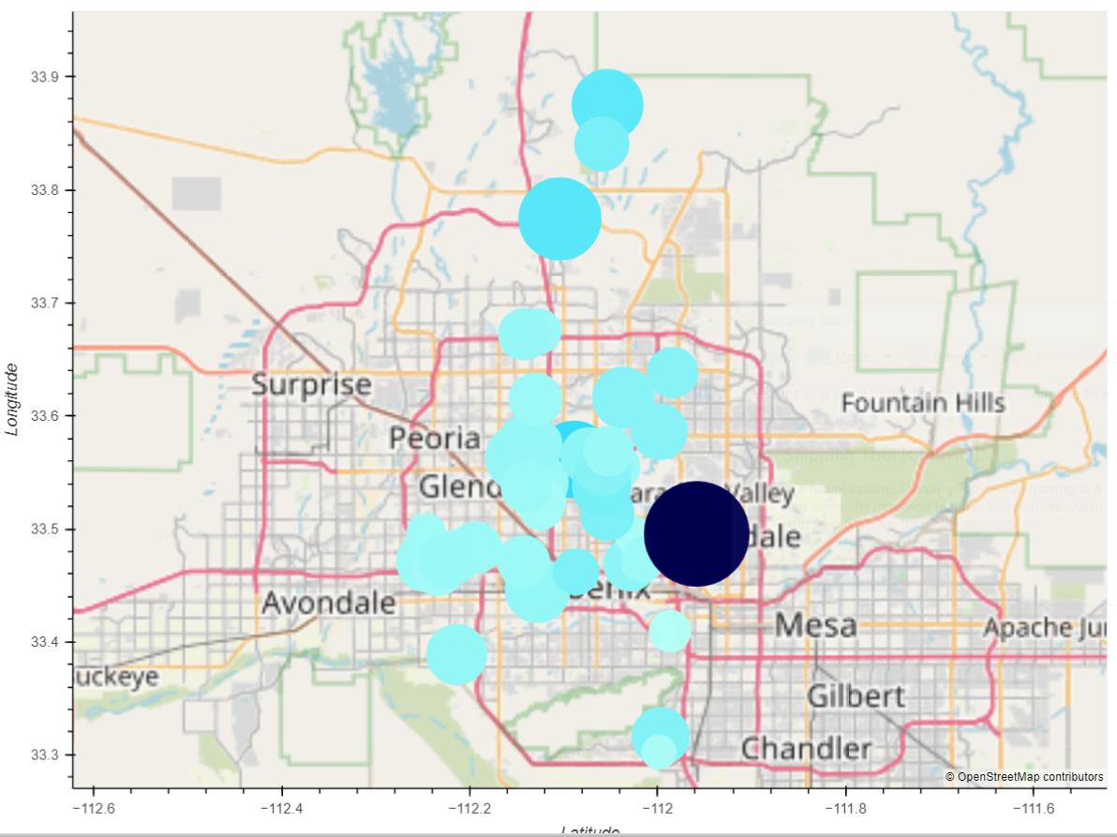
Homes list by sales price and square footage

Slide 9
Identification of Low Risk, High Yield (Best Investment) Property categorized by Property Type, Bedroom size, community_amenities?
Question 2

Slide 10
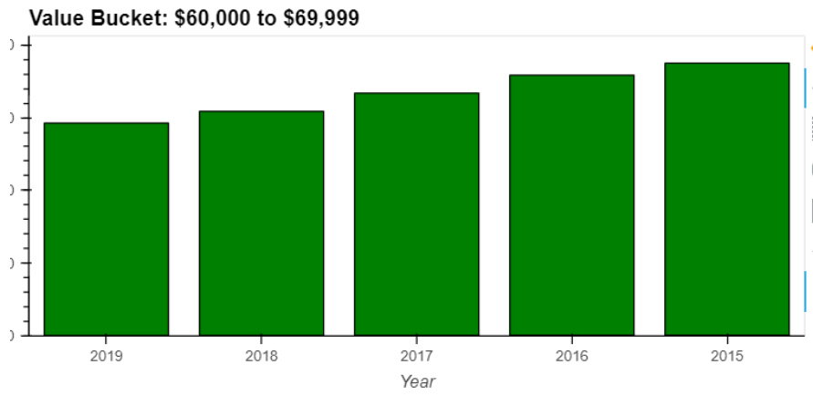
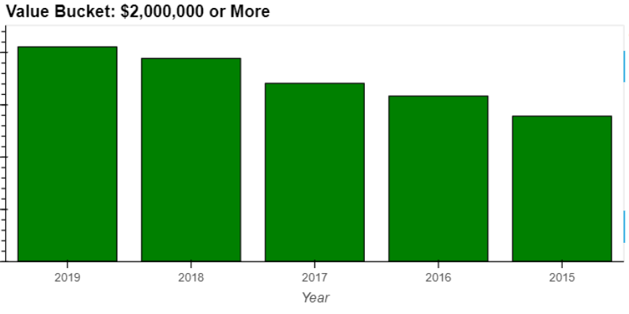
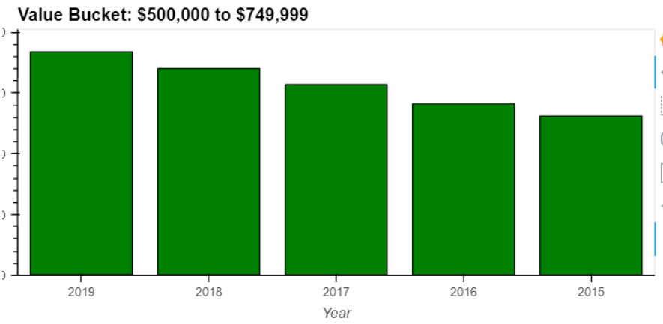
Value Bucket Ranges for Home Groups

Slide 11
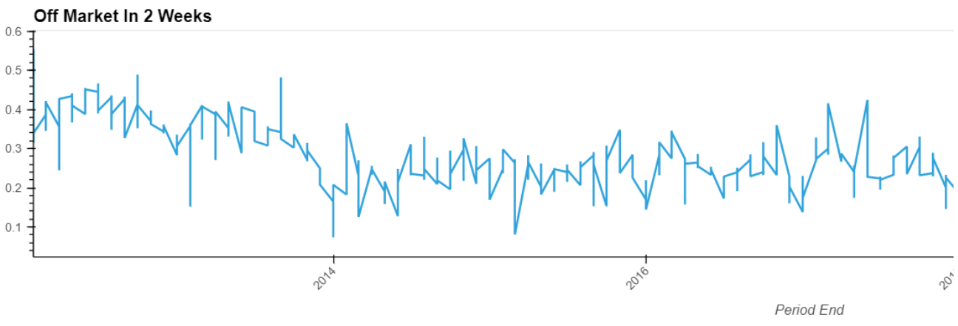
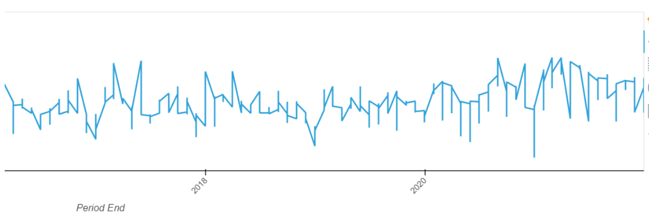
Off Market in 2 Weeks

Slide 12
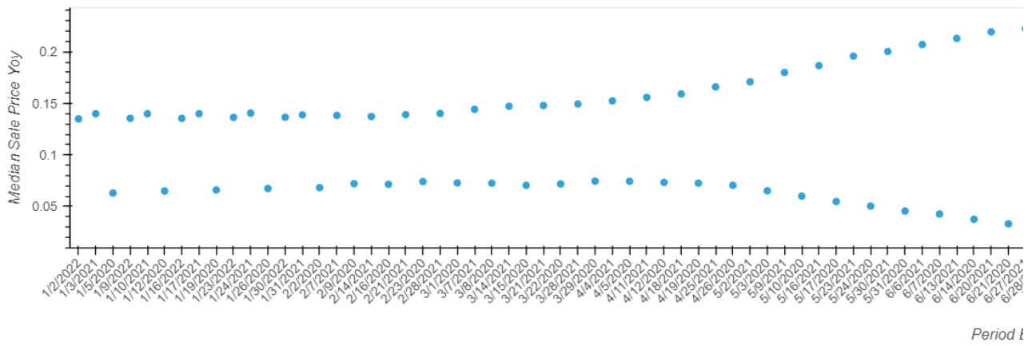
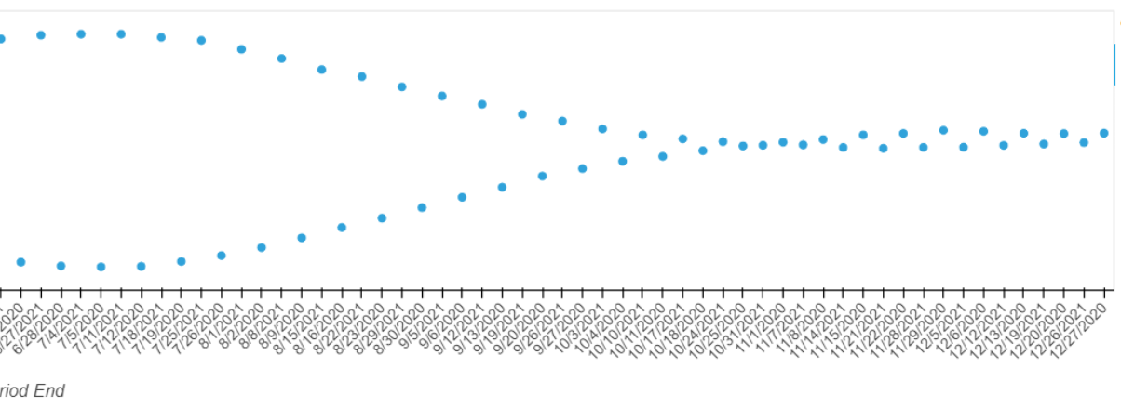
Median Sales Price Year Over Year

Slide 13
Is the housing market in Arizona healthy and sustainable.
Question 3

Slide 14
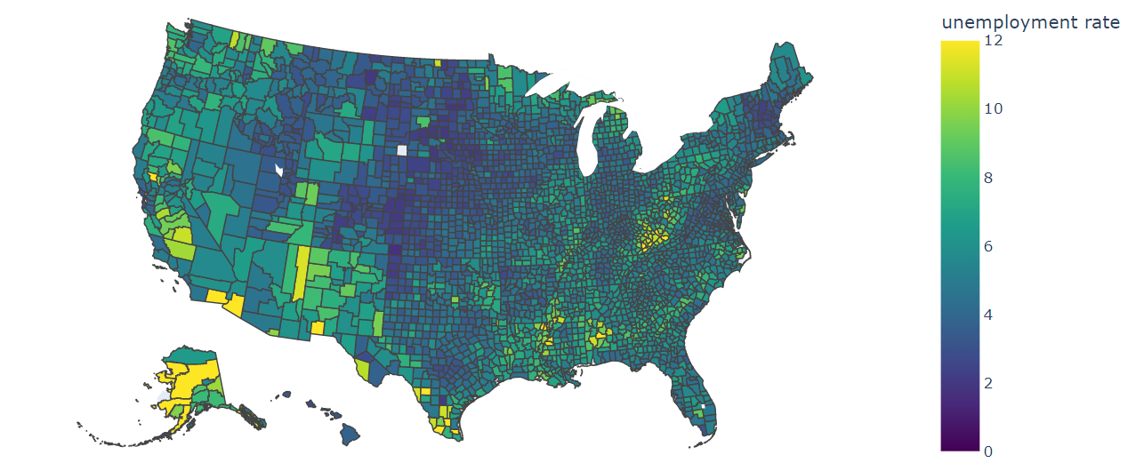
Unemployment Rate by County

Slide 15
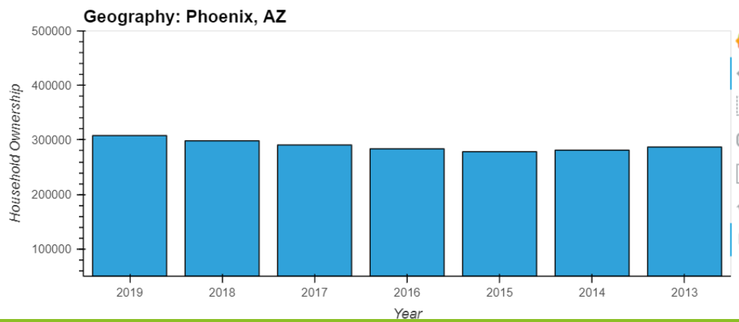
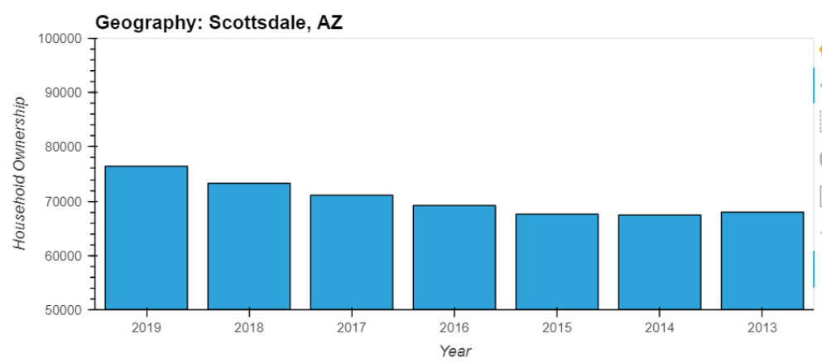
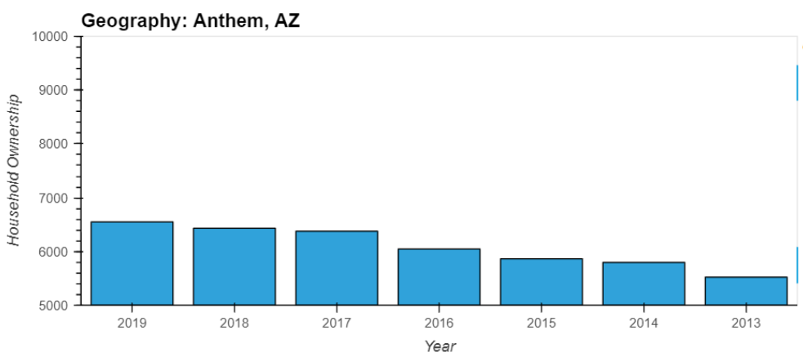
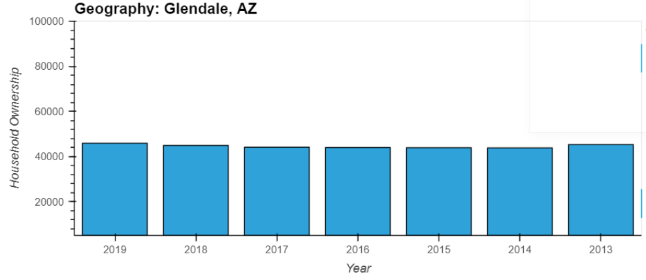
Household Ownership by Year for Maricopa

Slide 16
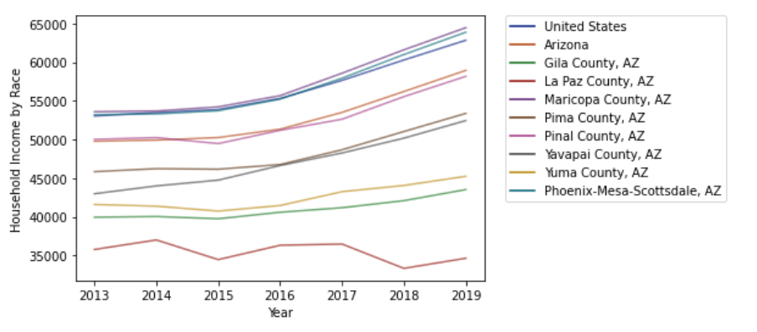
Household Income by Race

Slide 17
Conclusion
Team 2

